Slide 1



University Event Management System
Aditya Yendhe- 002308207
Atharva Tanaji Hambir - 002058951
Raksha Krishna Moorthy - 002341520
Sachin Ramesh Shet- 002316078
Varana Natvarlal Navadiya- 002051157

Slide 2
Objectives
1
﻿﻿Summary of the Problems Being Addressed
﻿﻿Challenges in event planning (venue booking, resource allocation, attendee management).
﻿﻿Inefficient tracking of attendance, ticketing and sponsorships.
2
Goals
﻿﻿Create a centralized platform for organizing and managing university events.
﻿﻿Improve communication between attendees and organizers.
﻿﻿Ensure efficient resource allocation and financial tracking.

Slide 3
High-Level Design
1
Design Considerations
2
Approach
﻿﻿Modular design to handle user roles (Student, Faculty, Admin).
﻿﻿Entity-Relationship (ER) modeling for database design.
﻿﻿Support for multiple events, resource allocation and venue reservations.
﻿﻿Use of normalization to avoid redundancy.
﻿﻿Secure payment and sponsorship management.
﻿﻿Integration of GUI and reporting tools for usability and insights.

Slide 4
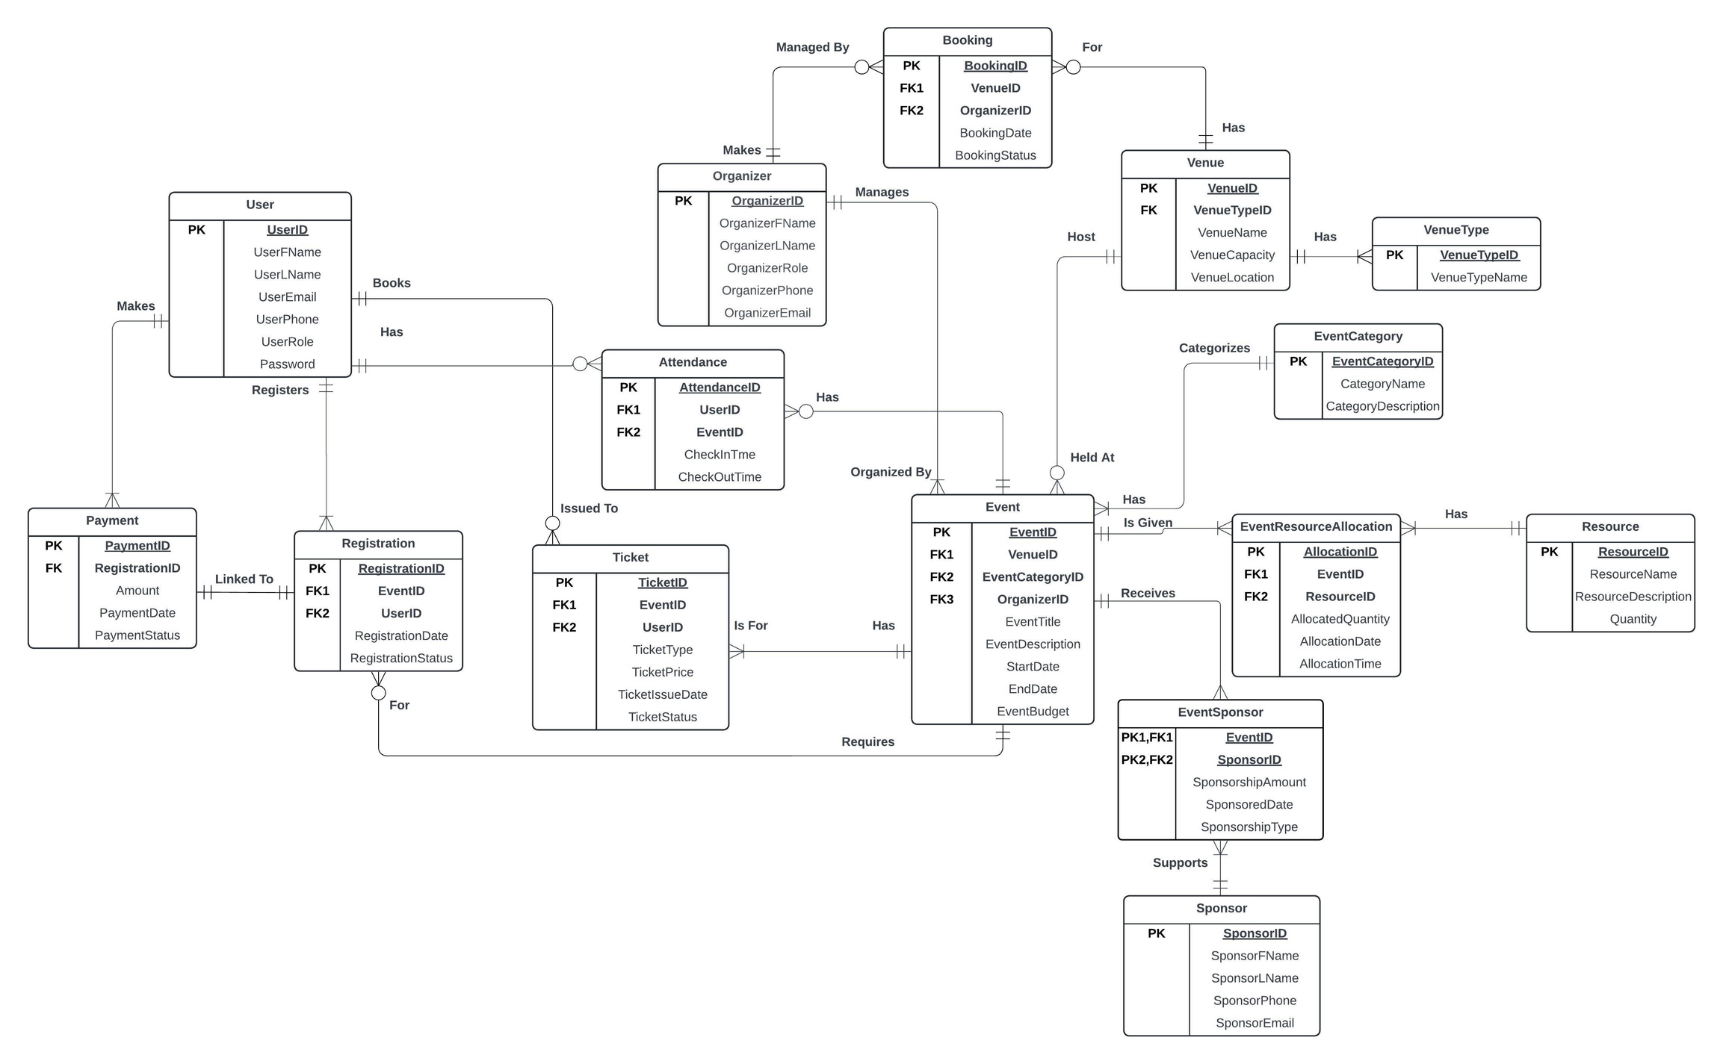
E-R Diagram

Slide 5
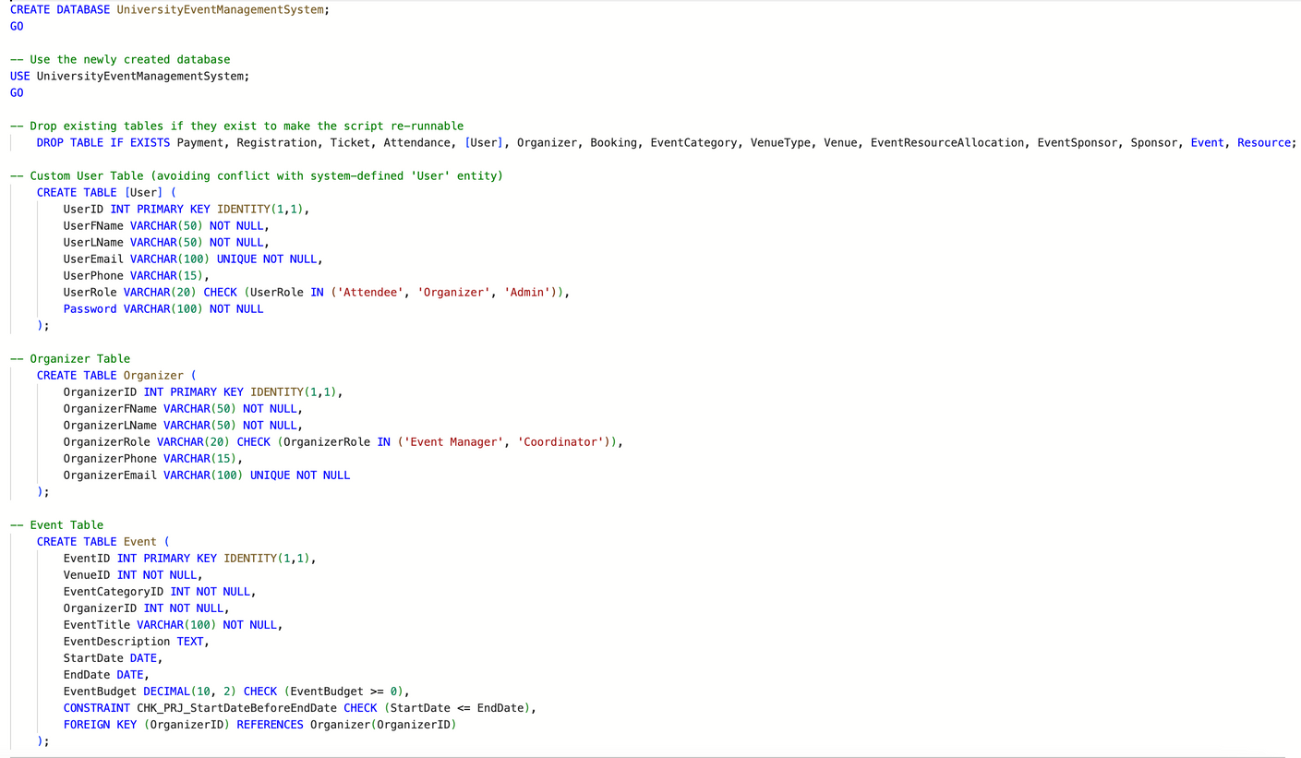
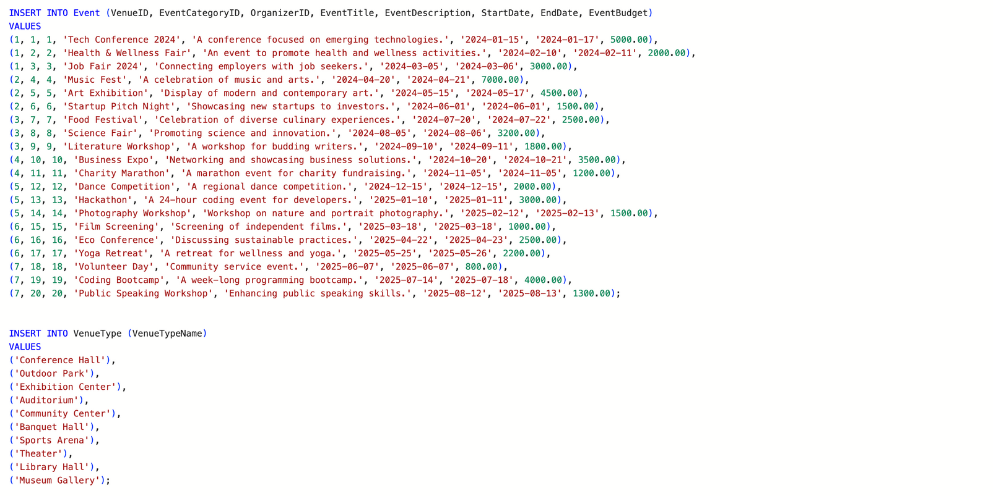
Database Objects
DDL
DML

Slide 6
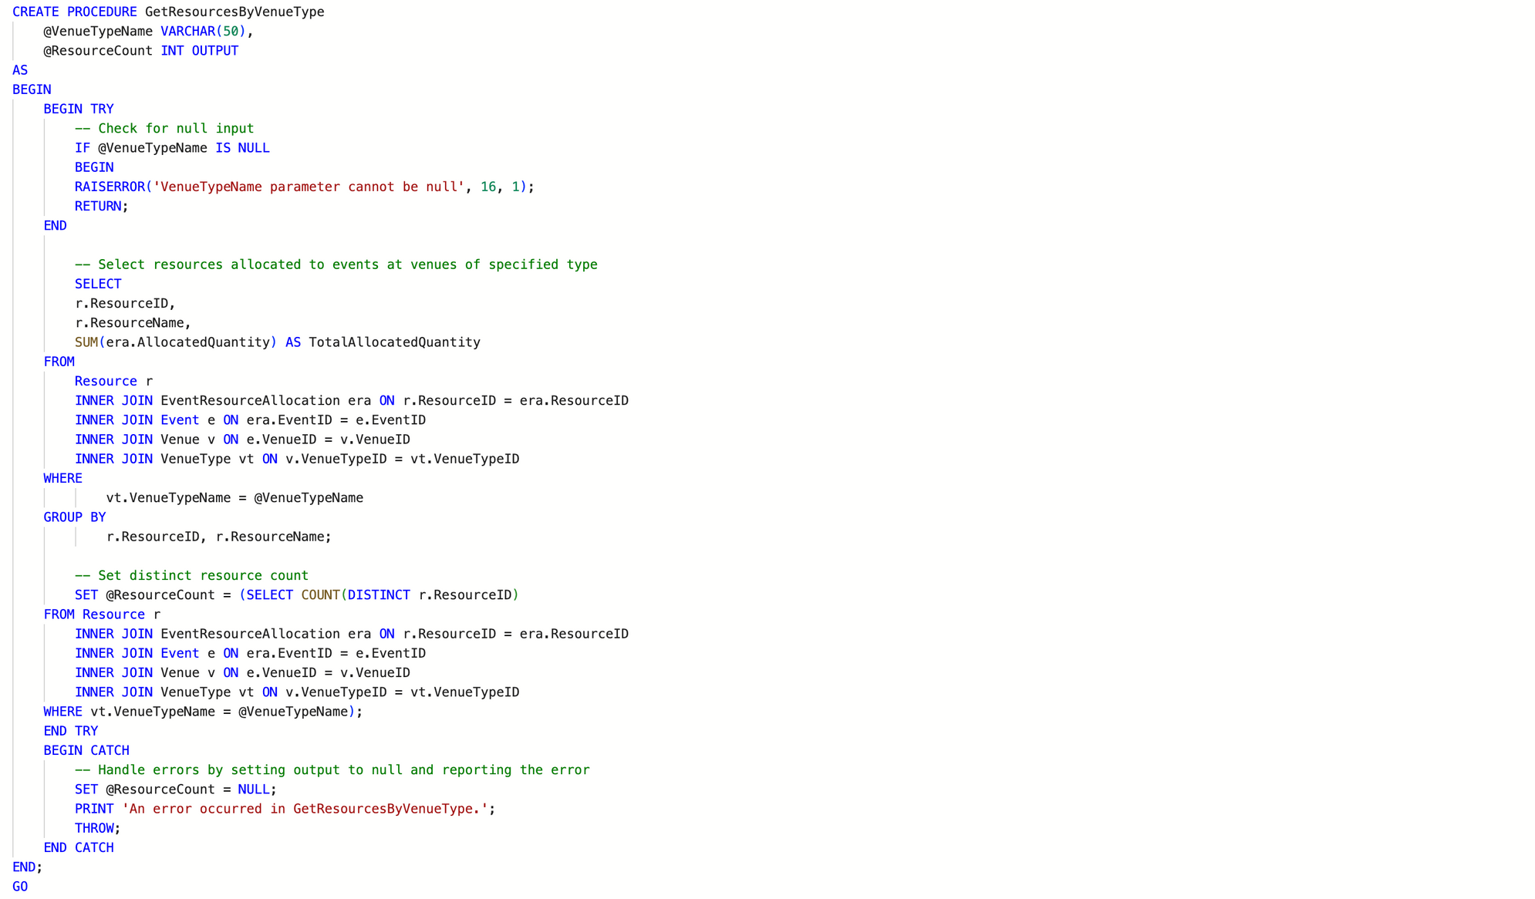
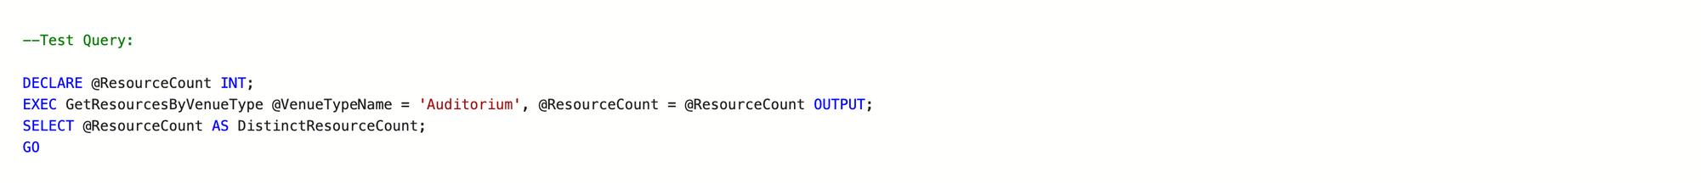
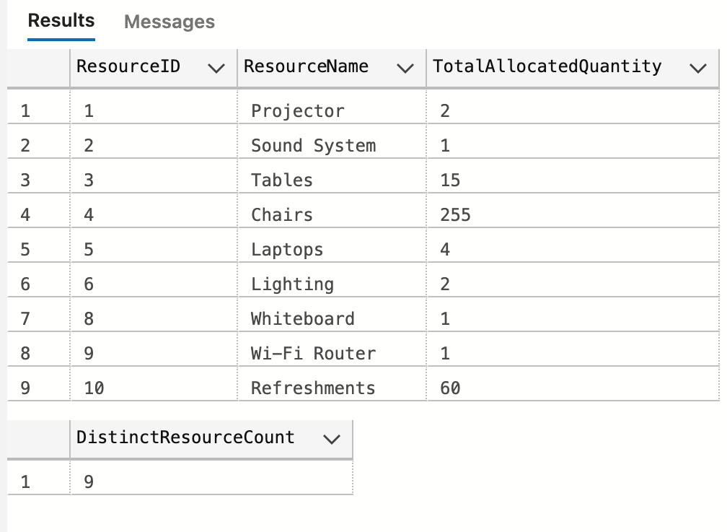
Database Objects
Stored Procedure
Lists all resources allocated to events held at venues of a specified type

Slide 7
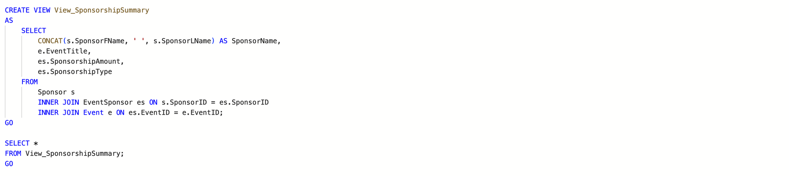
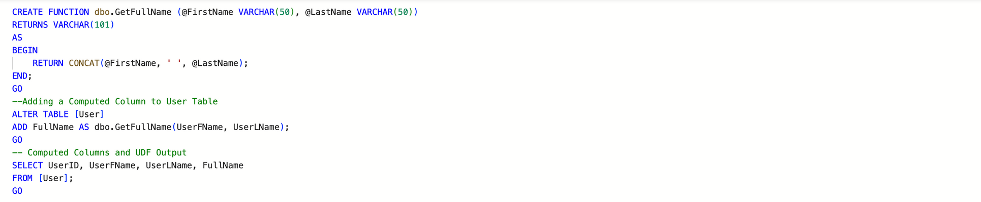
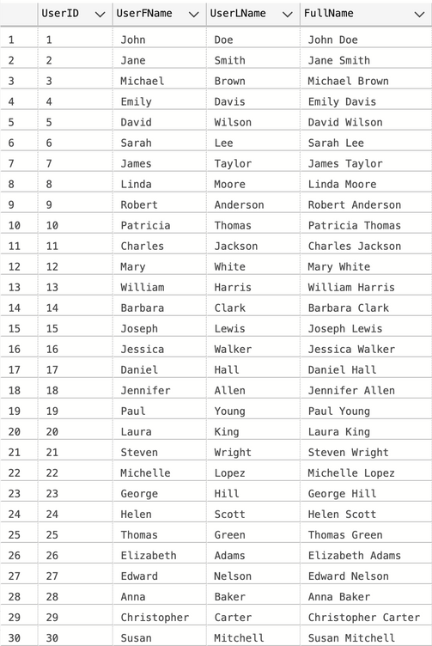
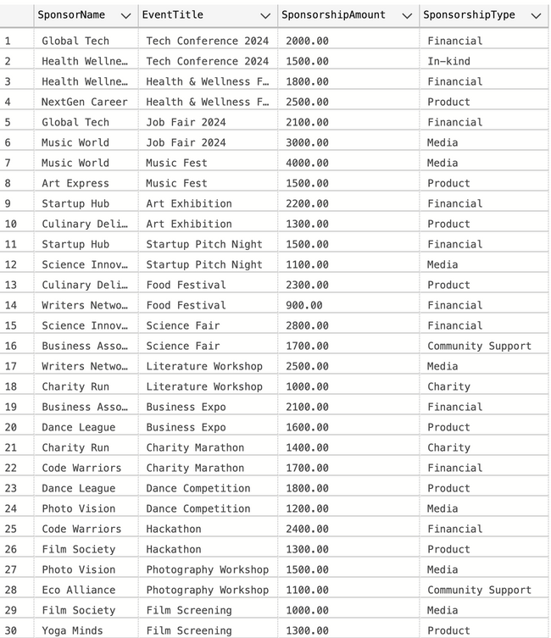
Database Objects
View
Function
View_SponsorshipSummary: Summarizes sponsorship
amounts by sponsor and event
User-Defined Function to Calculate FullName

Slide 8
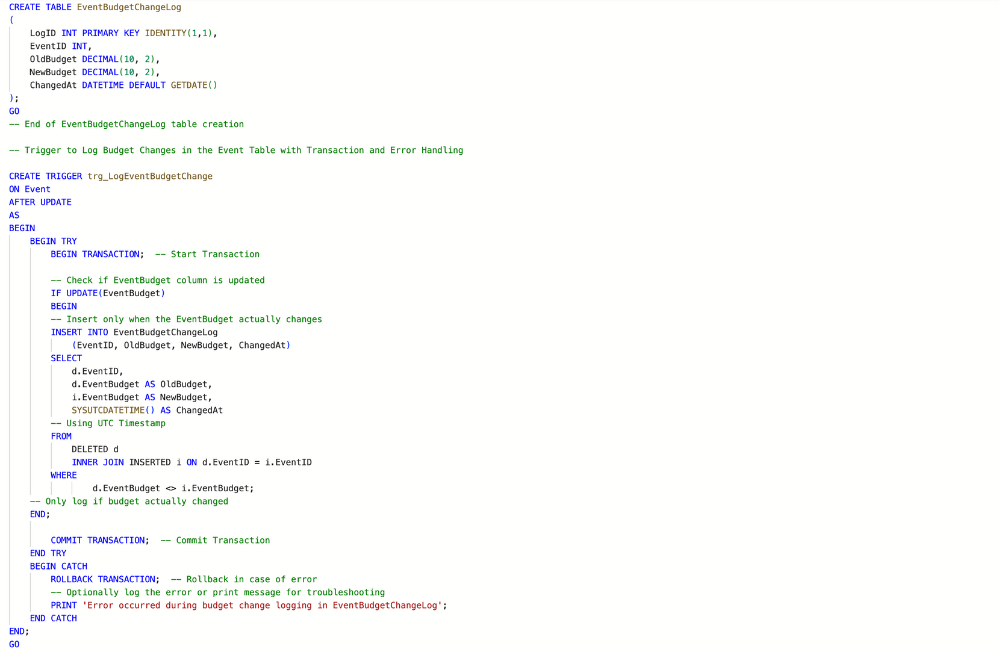
Database Objects
Trigger
Trigger to Log Budget Changes in the Event Table

Slide 9
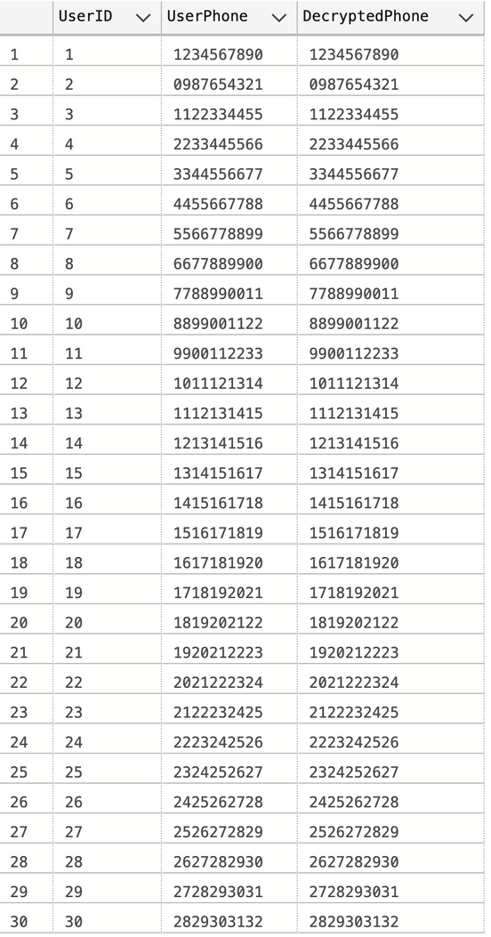
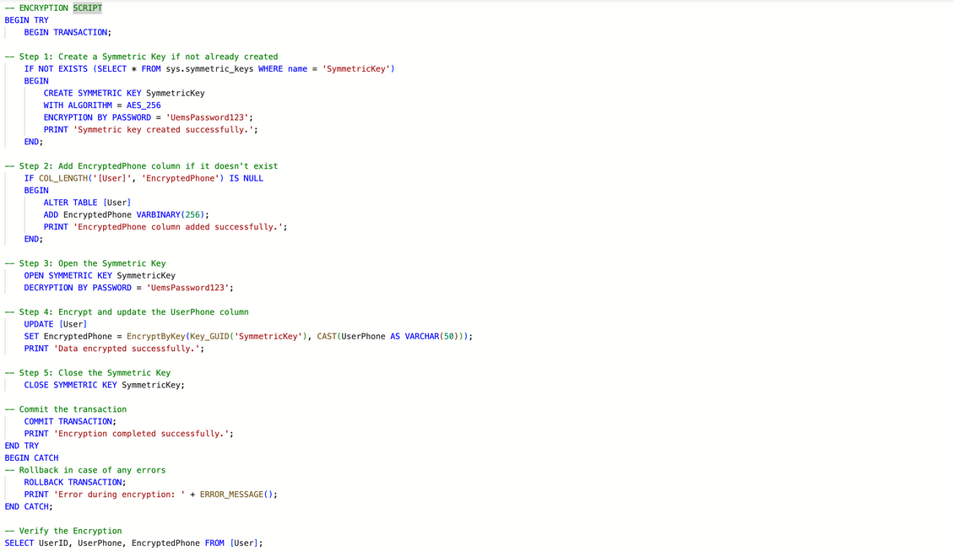
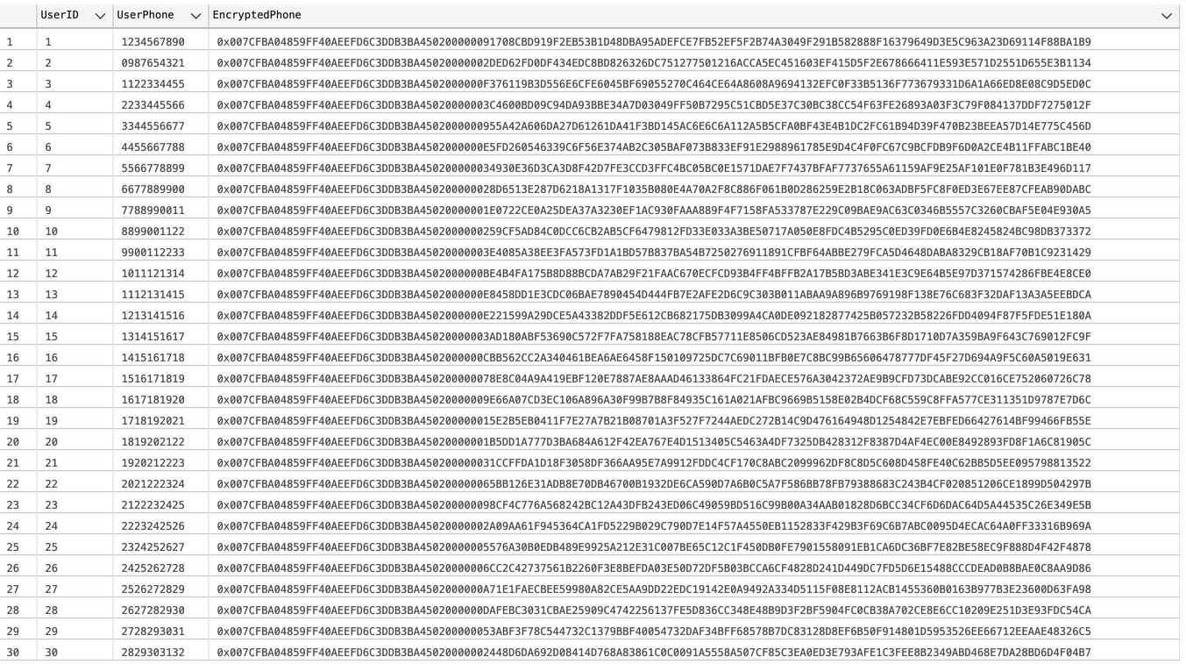
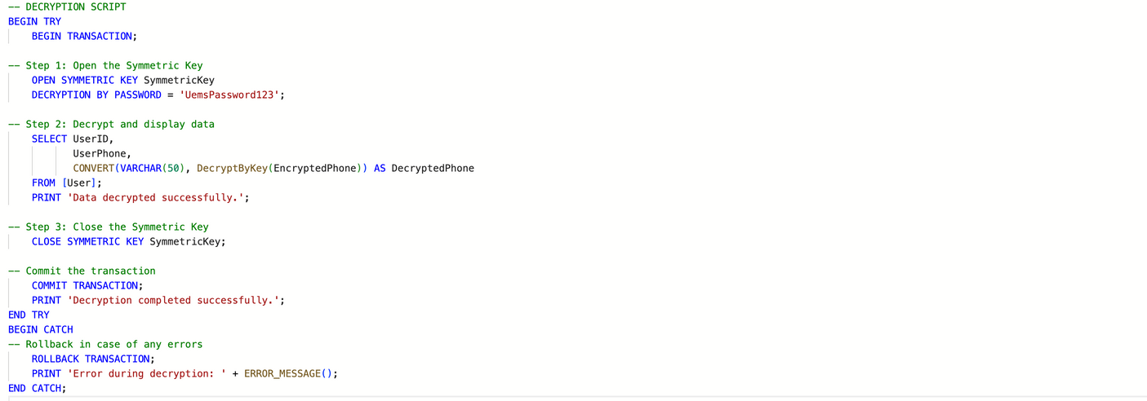
Database Objects
Encryption and Decryption

Slide 10
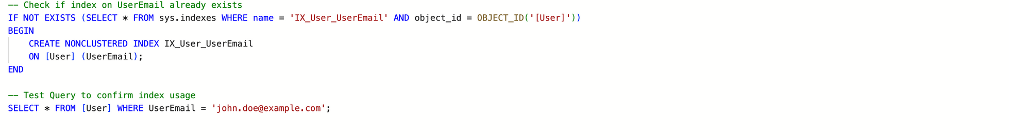
Database Objects
Non-Clustered Index
Check if index on UserEmail already exists

Slide 11
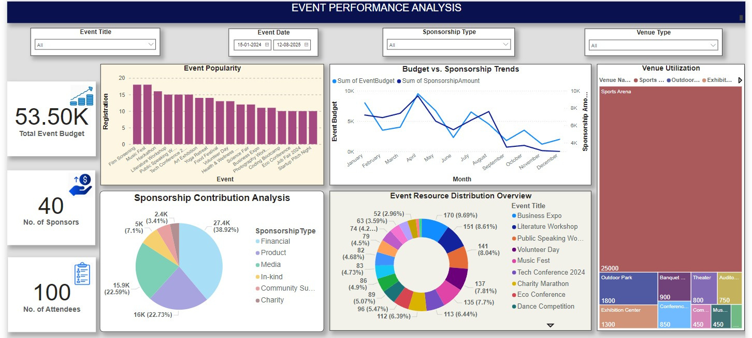
Dashboard

Slide 12
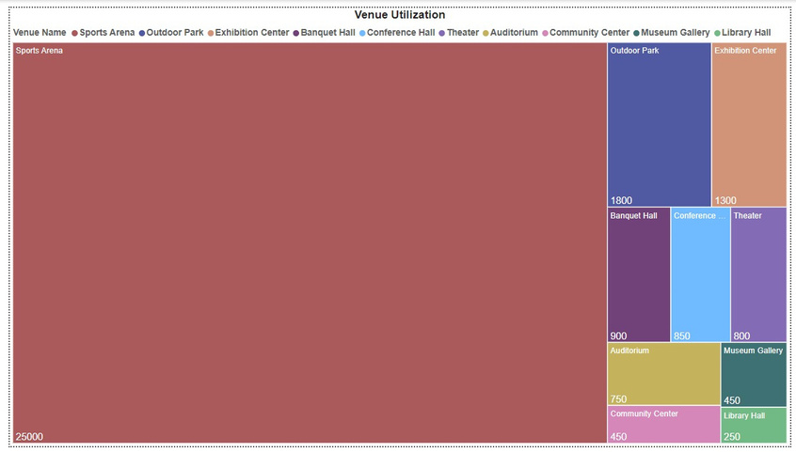
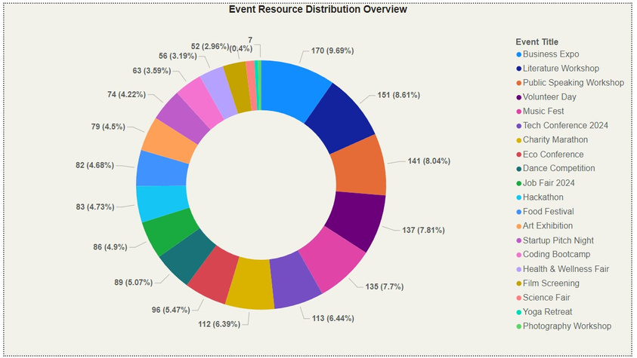
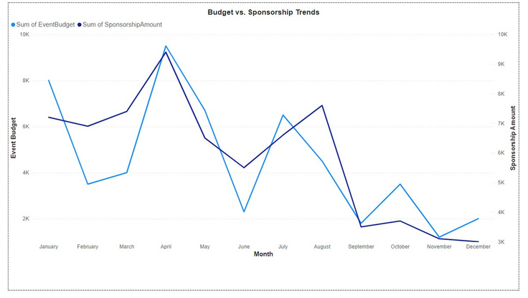
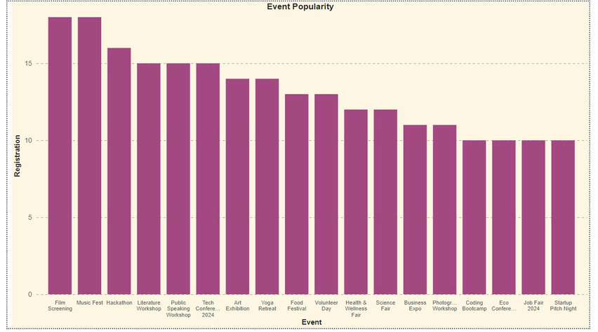
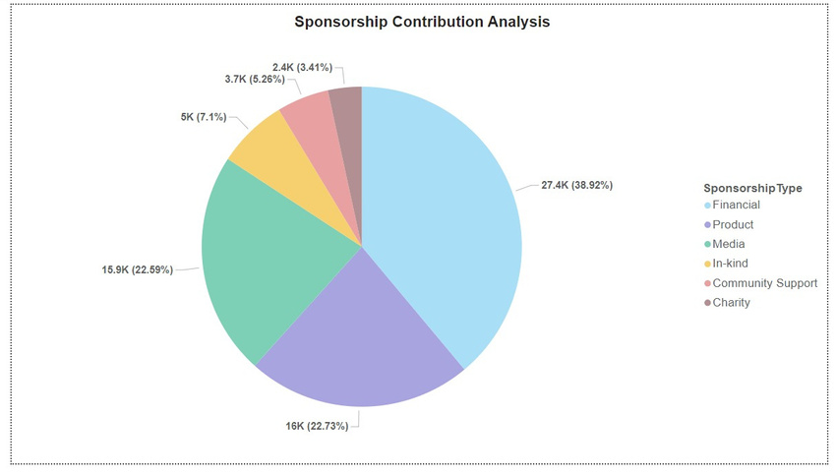
Power BI Reports
Visualization Utilization
Event Resources Distribution Overview
Budget Vs Sponsorship Trade
Event Popularity
Sponsorship Contribution Analysis

Slide 13
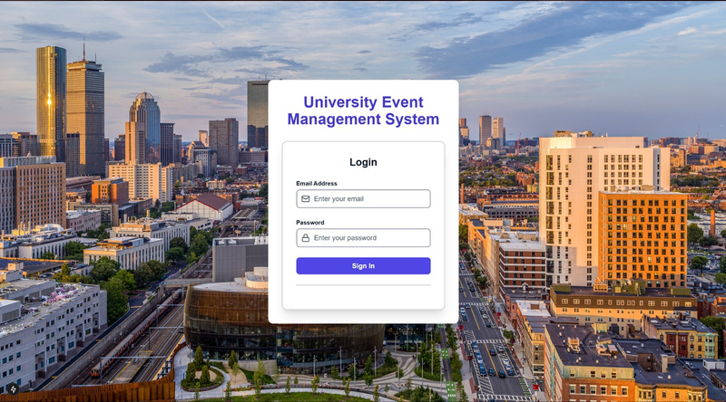
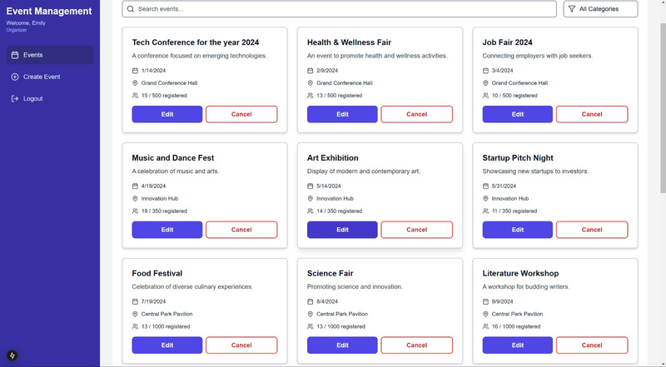
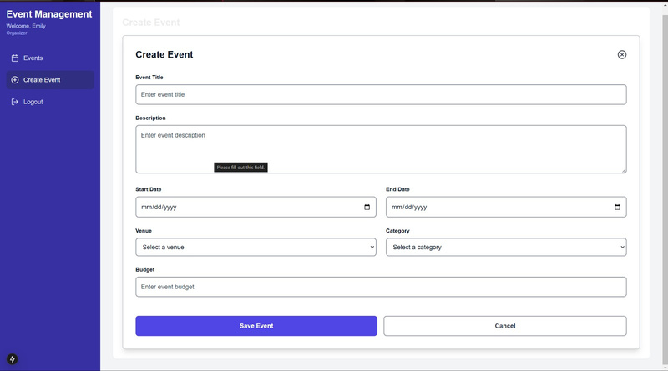
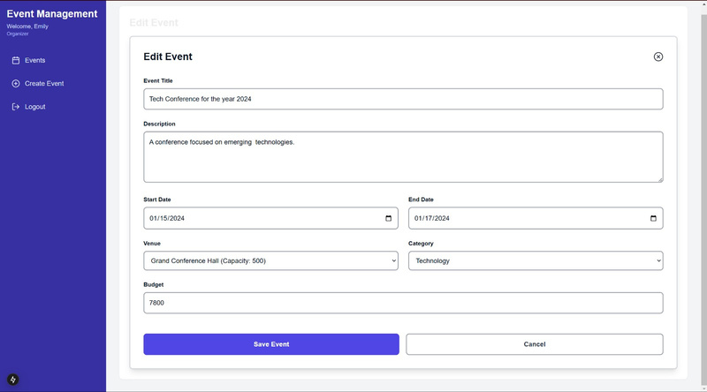
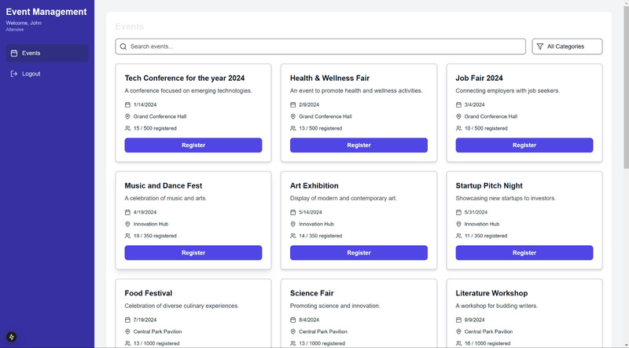
Graphical User Interface

